Slide 1
Why did the bicycle fall over?
Because it was two-tired!

Slide 2
Natural Language Processing
Encoding text
Language modelling, RNN and transformers
Transfer learning BERT

Slide 3
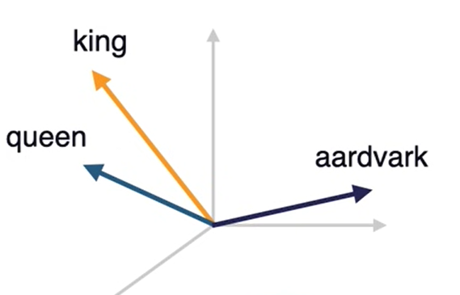
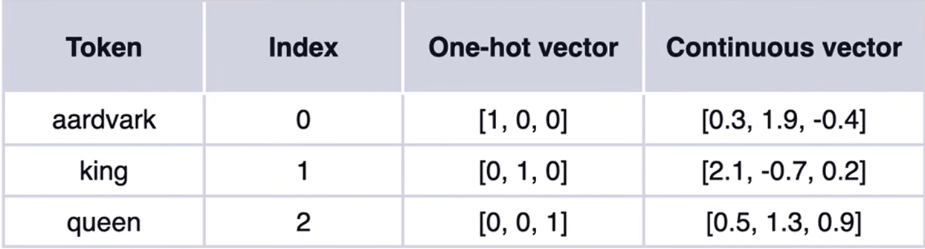
Encoding text

Slide 4
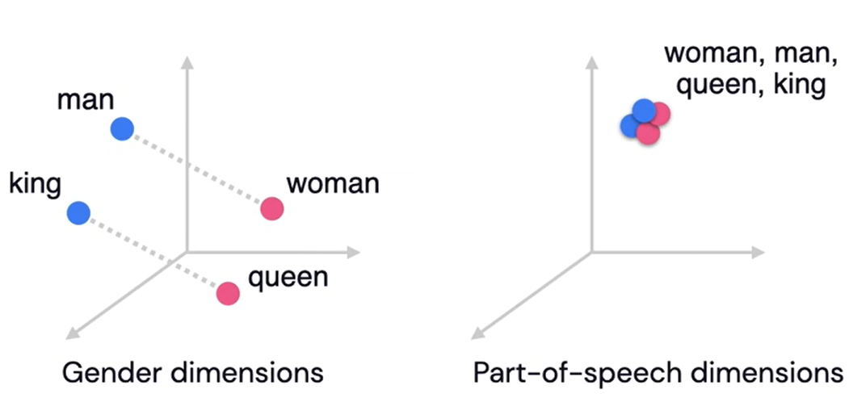

Slide 5
2014
Recurrent neural network
2017
Transformers

Slide 6
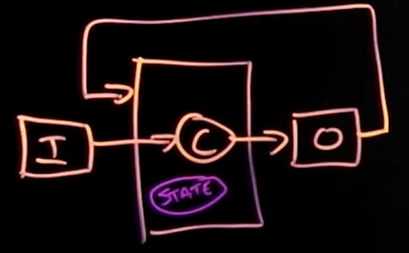
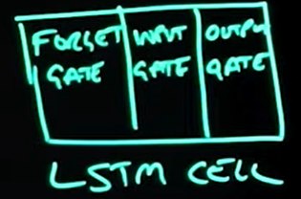
Recurrent neural network (RNN) (2014)

Slide 7
Disadvantages:
Slow O(N), N is the number of the token
Vanishing gradient: cannot process very long sentences (forgets)
Unidirectional: Process sentence from left to right

Slide 8
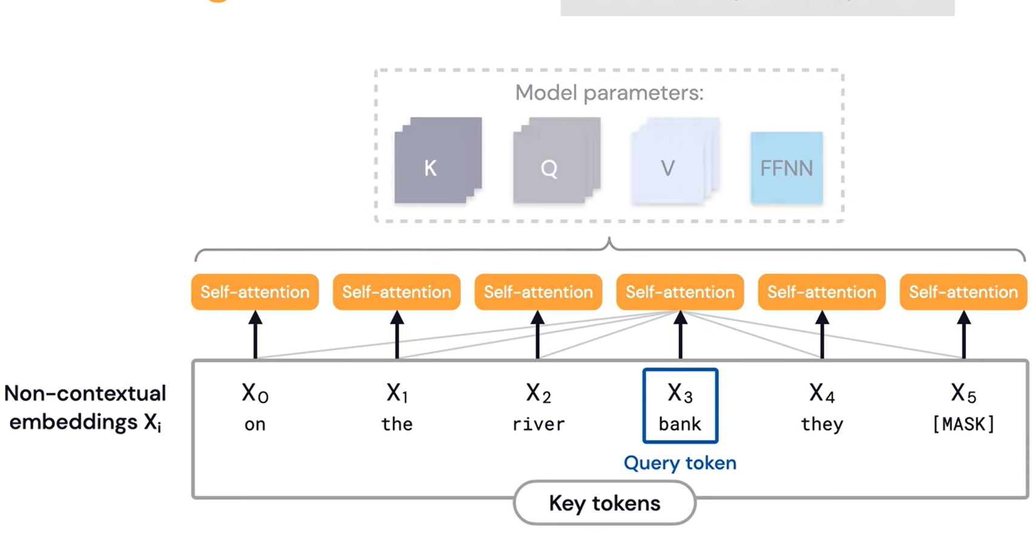
Transformers (2017)
Notes:
Semi-supervised Learning- pretrained in Unsupervised Learning with a large unlabeled data set, fine trained with supervised learning.

Slide 9
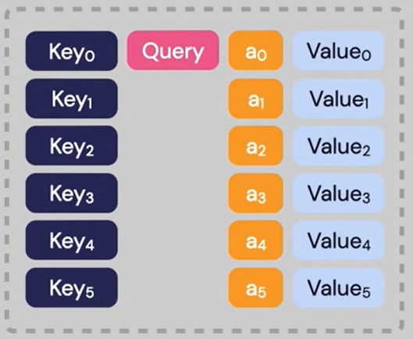

Slide 10
Disadvantages:
Computationally intensive: O(N²L) (N: inputs, L: layers)
Length of the sentence needs to be set (512 tokens), otherwise needs to be truncated or padded.

Slide 11
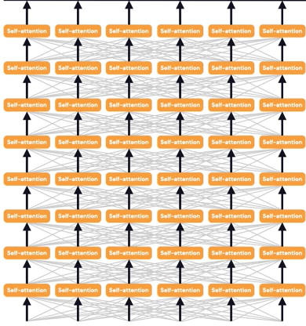
Notes:
Attention mechanism: it doesn’t process data in order, it runs encoder decoder sequences in parallel, hence speeding up the training time. (e.g. when translating a paragraph, transformers tend to understand the context rather than focusing on single words.)

Slide 12
